Slide 1
Analysis of Passwords exposed in multiple Data Breaches
Ashwin Patil

Slide 2


Goals
Problem statement – Behavioral analysis of the password across various sectors and regions to understand common trends which are security risks.
Data mining to analyze the password characteristics and character usage.
Predictive Modelling to detect if Password is from specific region (e.g.UK or Russia).
Analyze statistical significance and influence of password characteristics (alphanumeric, punctuation, password length) to the model prediction outcomes
Business use-cases of the models and models usage.

Slide 3
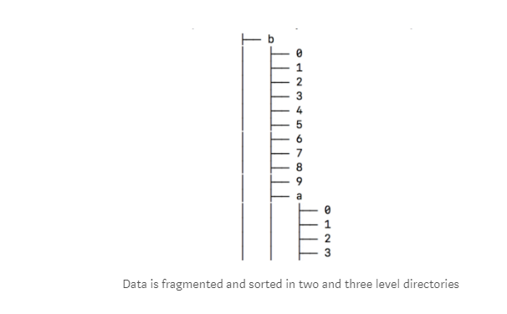
DataSets
Original archive of 41 GB having 1981 files were found on various social media blogs with common Pastebin link containing both compressed and uncompressed version of the archive
The data is structured in an alphabetic directory tree fragmented in 1,981 pieces to allow fast searches.
The dump includes search tools and insert scripts to do faster searching of passwords/ emails.
https://medium.com/4iqdelvedeep/1-4-billion-clear-text-credentials-discovered-in-a-single-database-3131d0a1ae14
https://www.reddit.com/r/pwned/comments/7hhqfo/combination_of_many_breaches/

Slide 4
Data Cleaning and Preparation
Out of the total 1986 files
the total records- 1400553869 (1.4 Billion)
no of duplicates - 202281 were found. (202K- 0.014 %)
647701 (647K- 0.04 %) Records found with same EmailId and Passwords
105 Files were found with Invalid data with all NULL chars inside text files – total Size- 1.93 GB (4.8 %) (Out of Scope for Analysis)
2546790 (0.18 %) Records found with No passwords (Out of Scope for Analysis)
40140152 (2.86 %) Records found with less than 6 chars. (Out of Scope for Analysis)

Slide 5
Data Wrangling
Summary Dataset compiled grouped by EmailDomain and Password Length for Analysis and visualization.
S&P 500 Dataset with Sectors utilized to join against EmailDomain to discover corporate domains and sectors.
URLtools library was used to parse Email domain into domain, subdomain, suffix fields. This can be further categorized into regions/other criteria based on Top Level Domains.

Slide 6
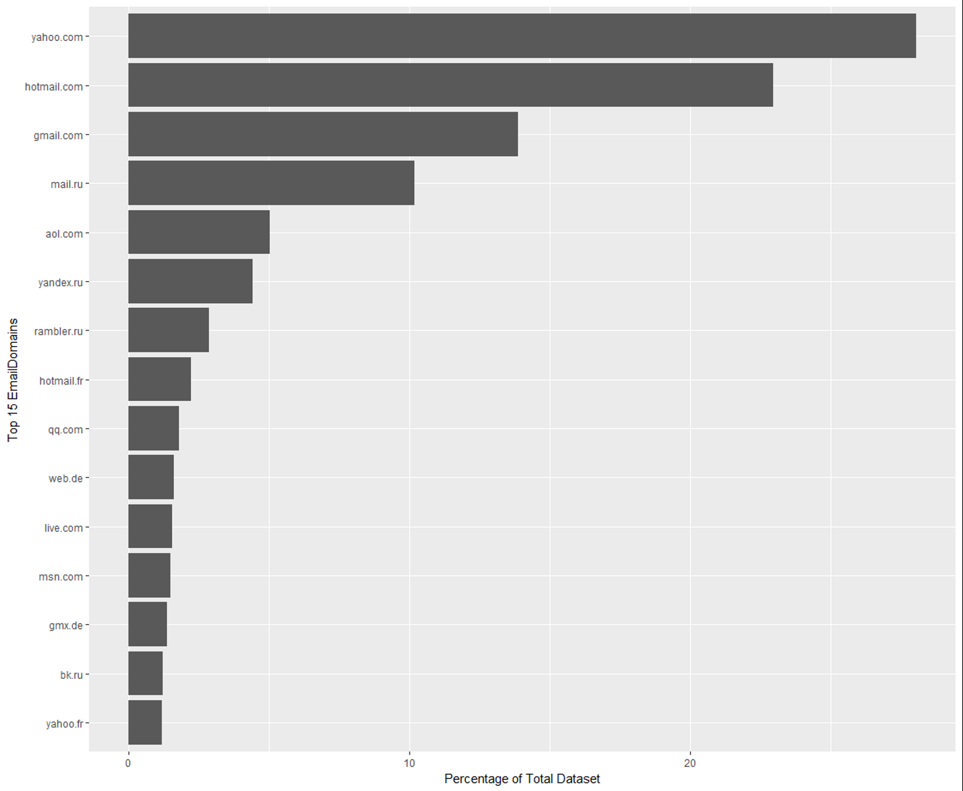
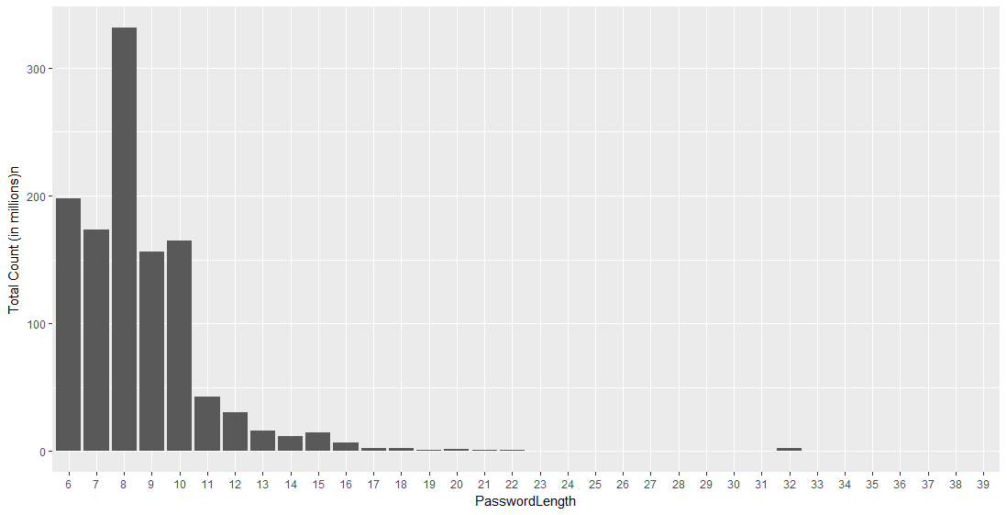
Data Visualization
Top 15 Email domains as compared to the total datasets.
Yahoo and related Email domains occupy more than 25% of the dataset
Password length Histogram :
Majority of Passwords falling in between 6 to 16 char length with 8 char as being the highest no

Slide 7
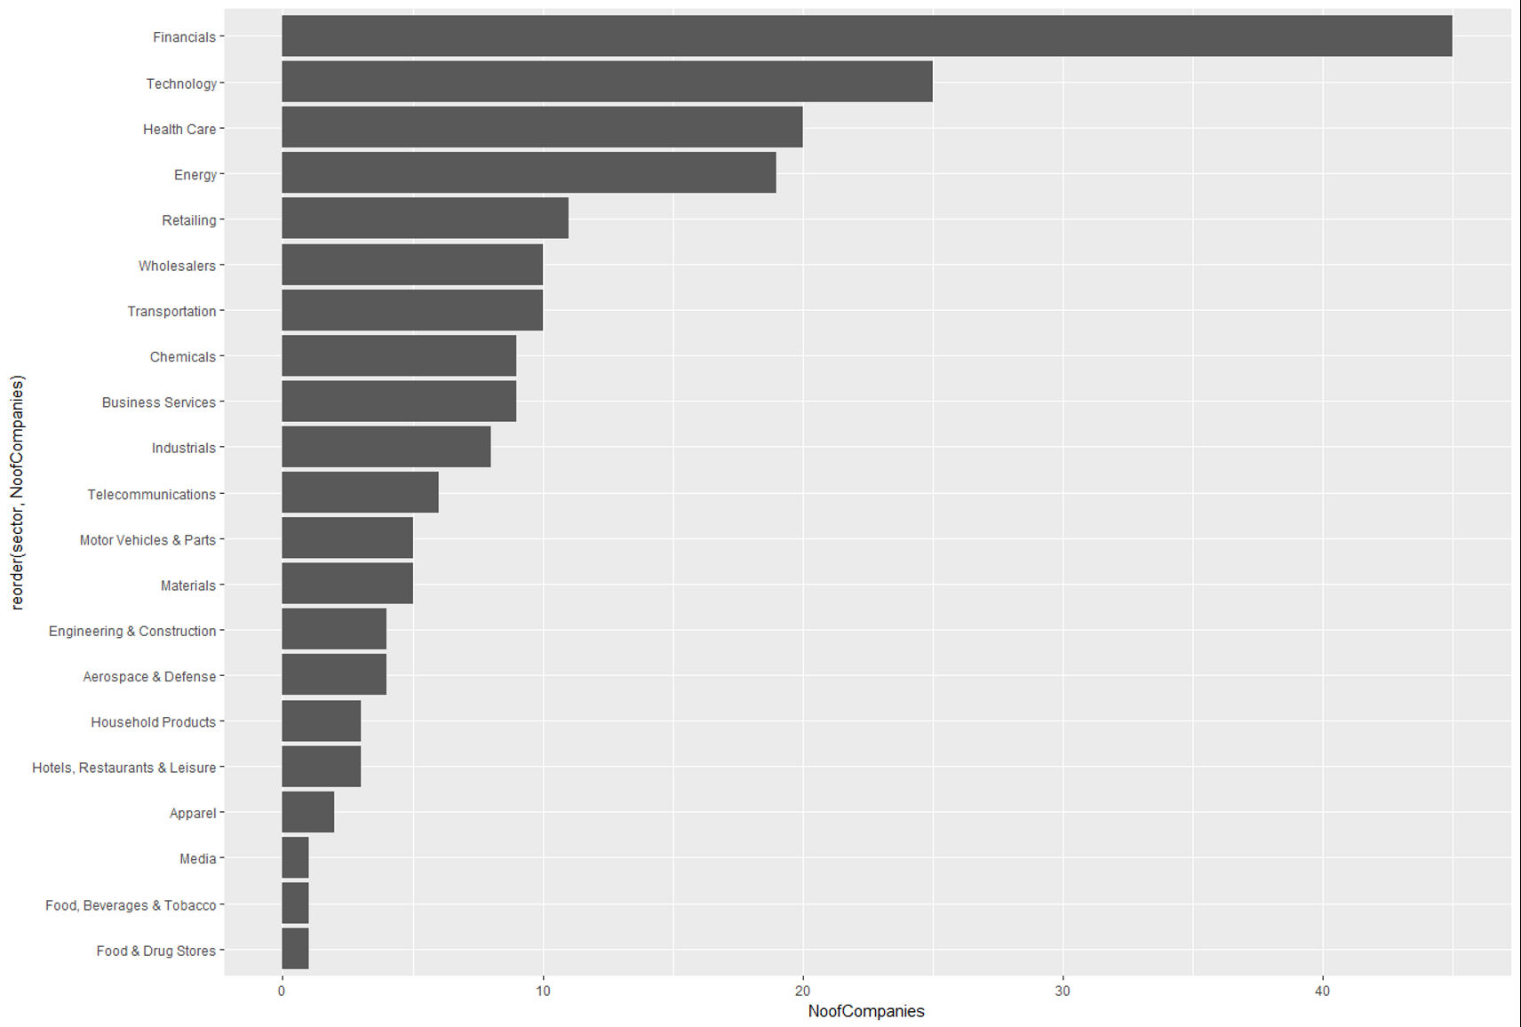
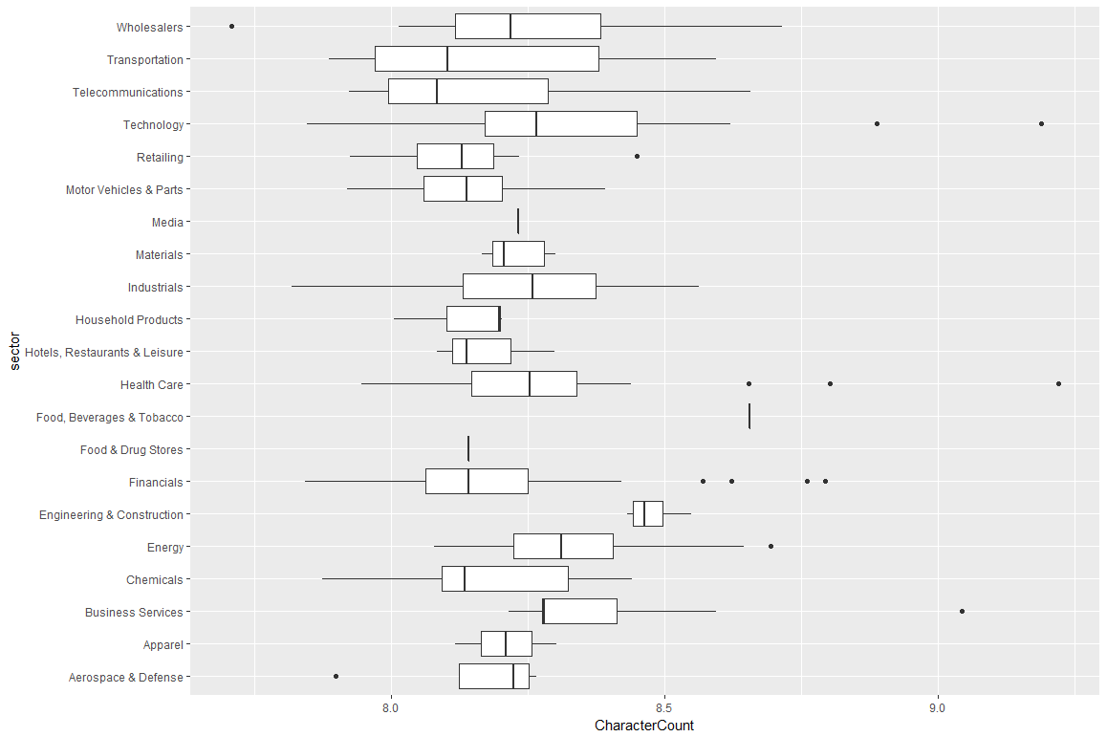
Data Visualization- continued…
Presence of 200 domains from 20 sectors of S& P 500 companies
with more than 40 Financial Sector companies EmailDomains presence
Avg Password length of S&P 500 Sector companies in the dataset.

Slide 8
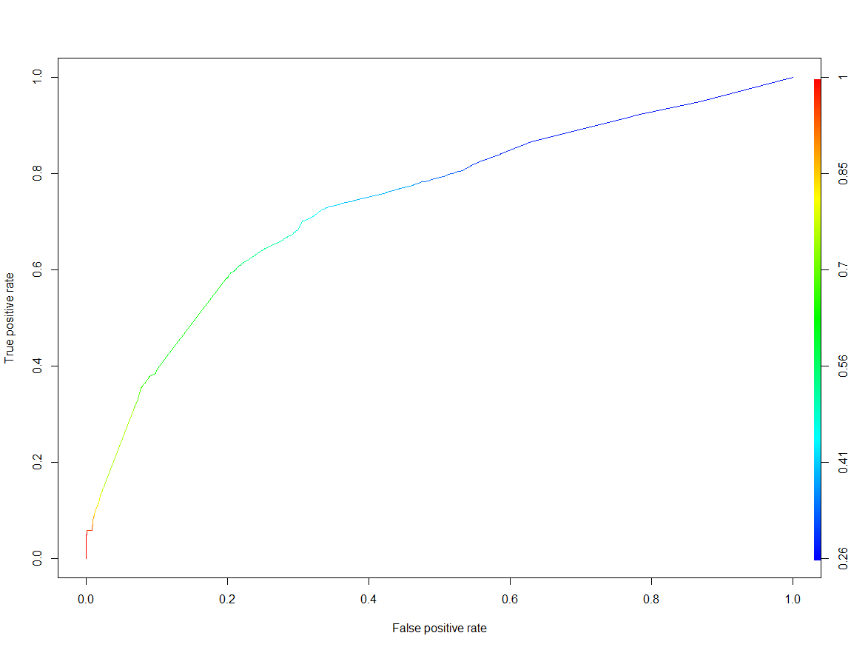
Logistic Regression
Can the regions be predicted from the password ?
Example dataset generated from gmail.co.uk and gmail.ru domain as test and training dataset.
The logistic function was generated based on the statistically significant variables present in the dataset.
Punctuation and Cyrillic chars were found statistically insignificant.
Model prediction accuracy of 68% was achieved.
ROC Curve - Diagnostic capability of the model as its threshold is varied

Slide 9
Model Outcomes and Business Use-cases
Statistically Insignificant - Cyrillic chars are only present in Russian Passwords and not in UK. (Expected due to regional/ non-US keyboard usage)
Strong Correlation – Upper, Lower Alphanumeric and Numeric count inclined towards UK region Passwords.
Higher total Password length inclined towards predicting RU region passwords.
Business Use-cases:
Password Strength/complexity benchmarking.
Regional attributions in case of investigations of passwords associated with malicious activity
Higher value of ‘x’ variable means.
Numeric Chars
Total Password length
Upper Alphanumeric Chars
Lower Alphanumeric Chars
More British
More Russian

Slide 10
Conclusion
The breach compilation dataset had more than 200 Fortune 500 companies EmailDomains exposed with more than 20 sectors with majority of Financial sector companies.
Data wrangling can be used to derive password characteristics variables from the dataset
Password length of the entire dataset varied from 6 to 16 char length where as avg password length per sector was between 8 to 9.
By training sample UK and RU regional emaildomains dataset, one can try to predict the regions (UK/RU) based on password characteristics with 68% accuracy.
Public Email Services/Corporate sectors does not usually handle passwords in cleartext formats but this data analysis can be used in strengthening existing security controls/ regional attributions in case of any investigations where only password is known.
Project Code Repo :
https://github.com/ashwin-patil/springboard-intro-to-datascience/tree/master/capstone_project
Detailed Technical Report :
Analysis of Passwords from BreachCompilation Dataset

